Slide 1

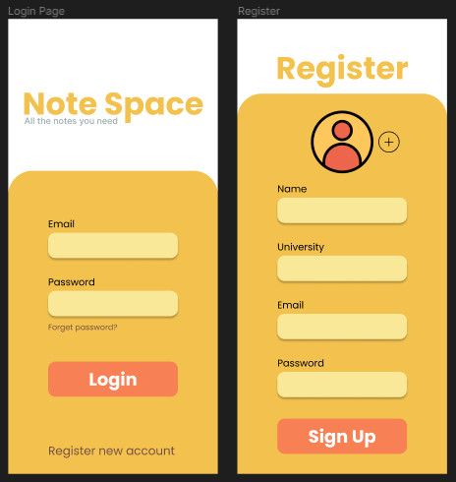
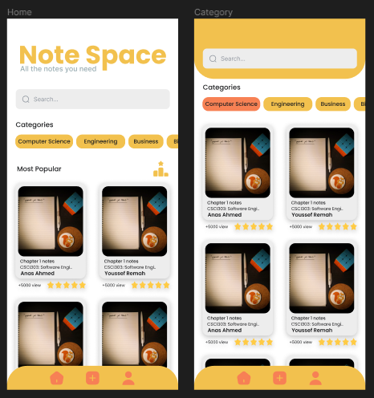
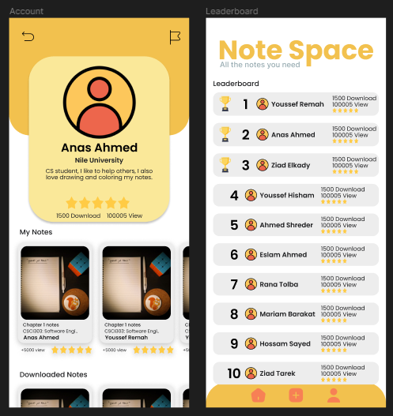
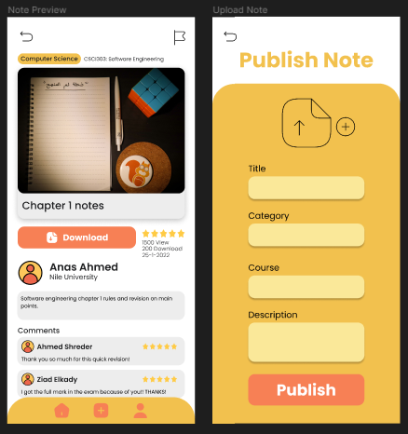
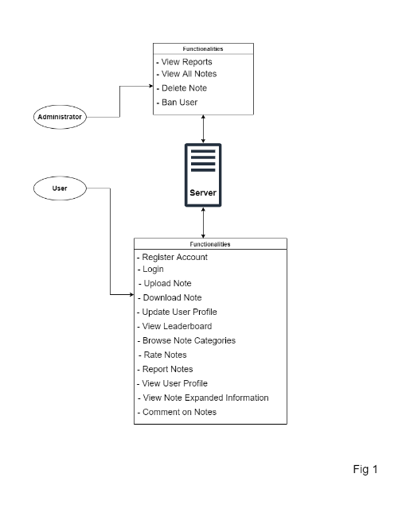
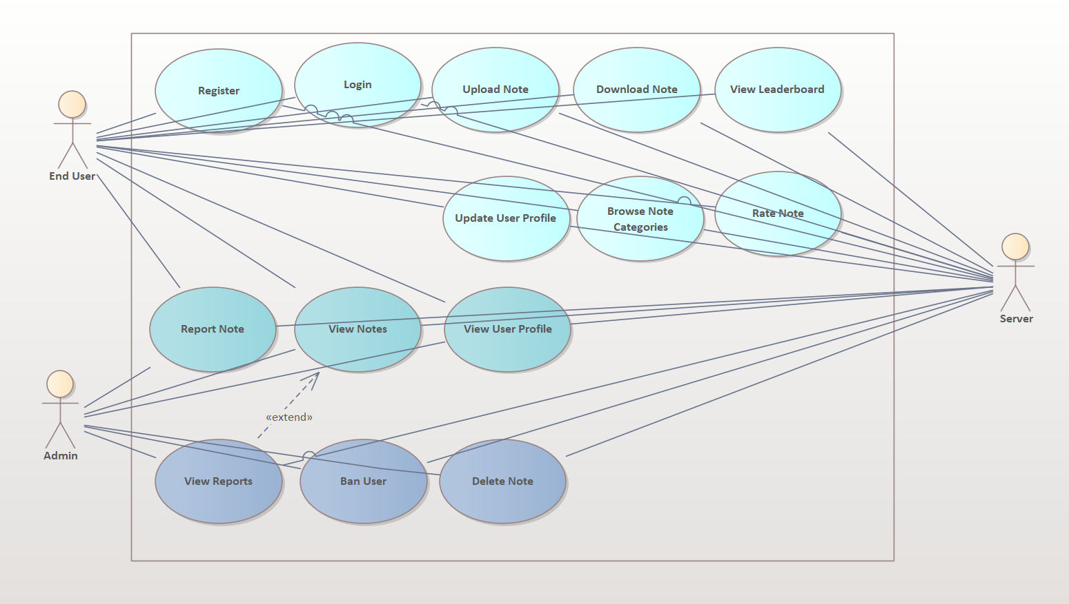
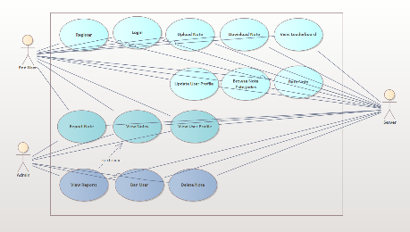
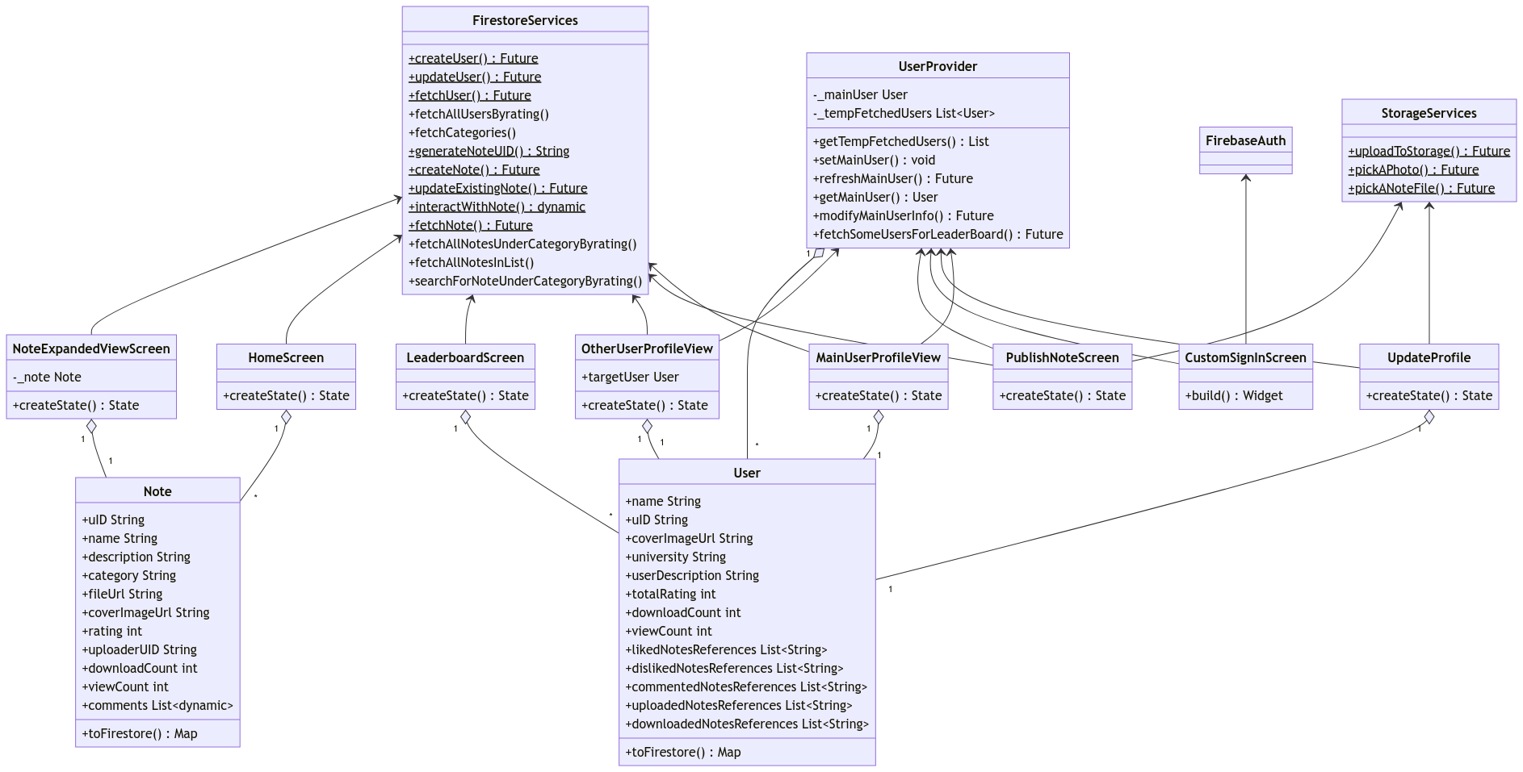
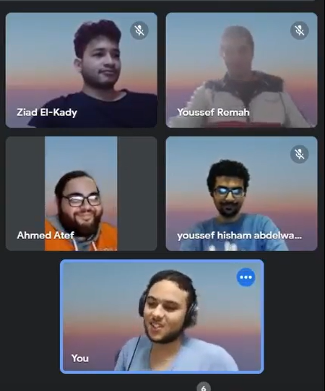
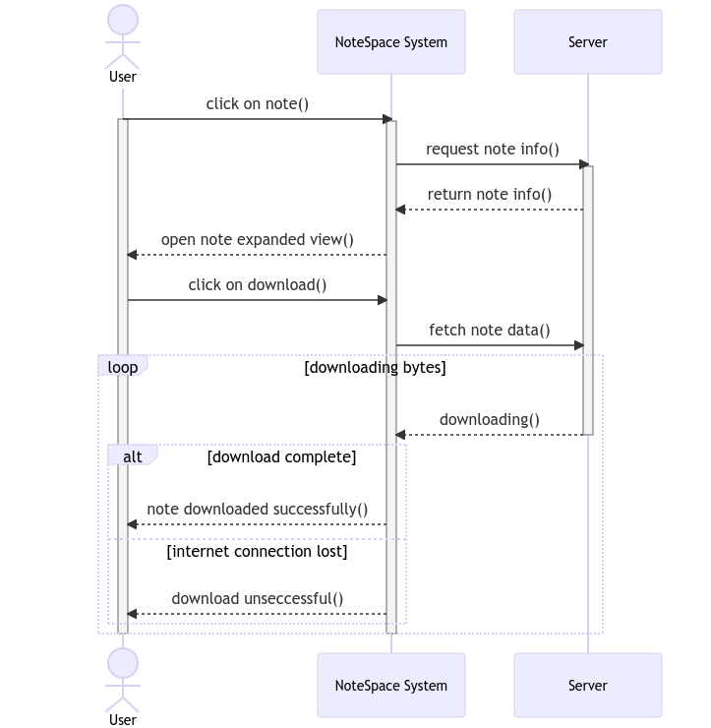
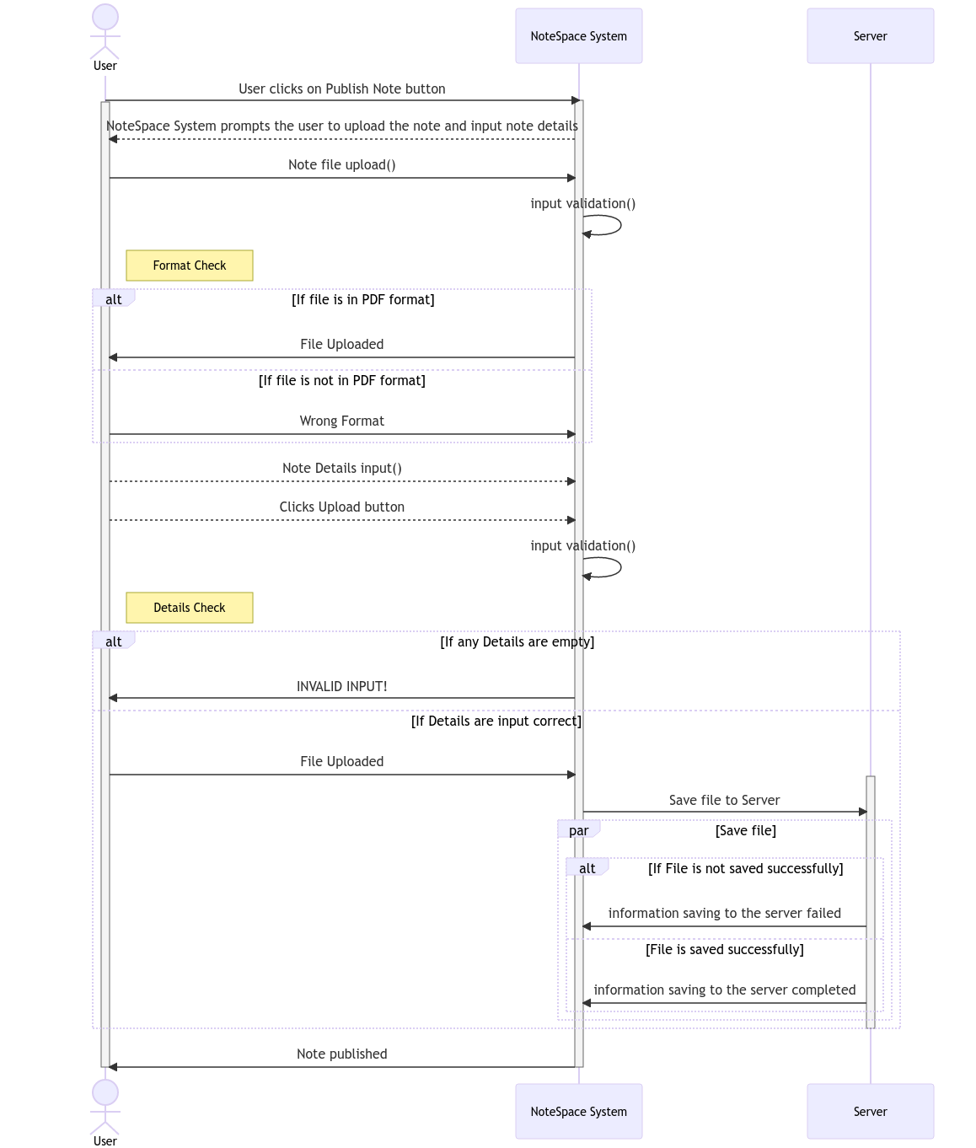
CSCI313
Dr. Walaa Medhat Asal
Note Space
Abstract
Methodology
Results
"Note Space" is a mobile application that allows students of any discipline to help each other by uploading their notes for everyone to benefit from and contribute to creating a note taking platform. Firstly, users will have to register with a valid email to be able to use the service. Secondly, every member is required to provide a name for themselves, their university name, and may optionally provide additional information to populate their profile with such as a profile photo and a personal description. The system has two main categories of users : admins and members.
Note Space application will have an appropriate user interface design and is a self-contained, independent system. The system has two categories of users. The first one is the user and the second one is the administrator. The system uses the centralized database which contains all the information.
Note Space is developed using flutter to build a cross-platform mobile application. The application utilizes a Firebase cloud Firestore which is a cloud-based NoSQL database to save user data and note information on the cloud. Also, the system will require a functioning Firebase Storage to physically save notes on the cloud.
The deployment of the system is with an android device emulator using Android studio device emulator. Furthermore, the system is developed with Android software development kit (SDK) using Android Studio emulators and visual studio code integrated development environment for android OS on windows.
The system will run on any device with Android version 5.0 (lollipop) using Android SDK 21 or higher. So, any device that supports this version or higher versions can effortlessly run the system.
Account Creation
Browse Notes
Introduction
“Note Space” application will have an appropriate user interface design and is a self-contained, independent system.
The system has two categories of users. The first one is the user and the second one is the administrator. Each category has unique system features available to them independently .
The system uses the centralized database which contains all the information. It works on android phones running version 5.0 or higher.
Profile Dashboard , Leaderboard
Note information , Publish Note
Use Case Diagram
Conclusion
According to our observations and data we concluded the following:
1. The mean time between failures (MBTF) should be at least 90 days.
2. The system can only run on Android devices of version 5.0 or higher.
3. The system's response time shouldn't be longer than 2 seconds on receiving data from the server.
4. The system should be able to function 7 days a week, 24 hours a day
Class Diagram
Team Photo
The app will allow members to view, upload, and browse notes based on category. Additionally, the app will have a rating system where members can rate notes upon their quality. Furthermore, users will be able to comment on and report other notes as well
Download Note Sequence Diagram
Upload Note Sequence Diagram
Anas Ahmed – Ahmed Atef Gamal – Youssef Hisham – Ziad Elkady – Youssef Remah

